Slide 1
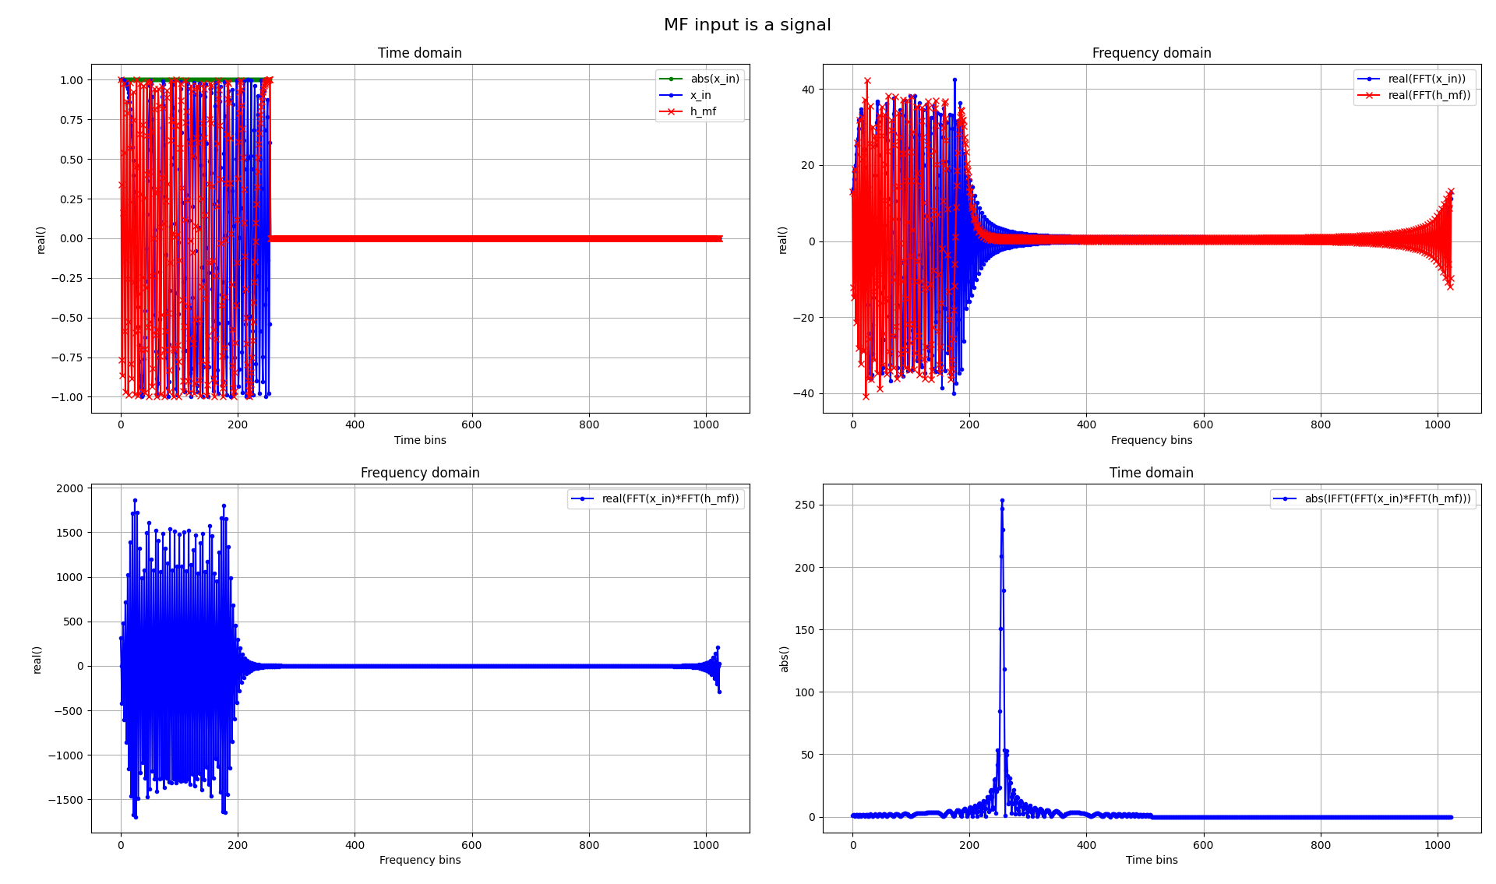
The Advanced Engineering Course
Primary Radar Signal Processing
Theory and Mathematical Model of Matched Filtering in frequency domain
Aleksei Rostov, PhD,
Senior R&D Engineer,
FPGA/Embedded Linux Developer,
aleksei.rostov@protonmail.com

Slide 2
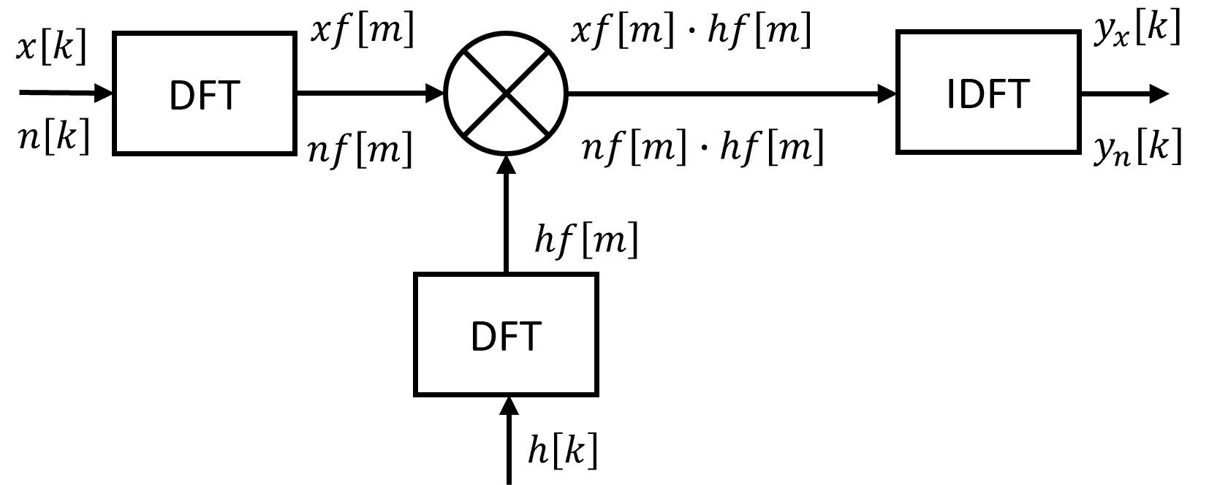
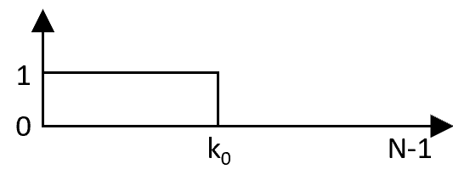
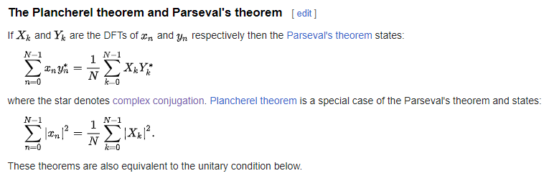
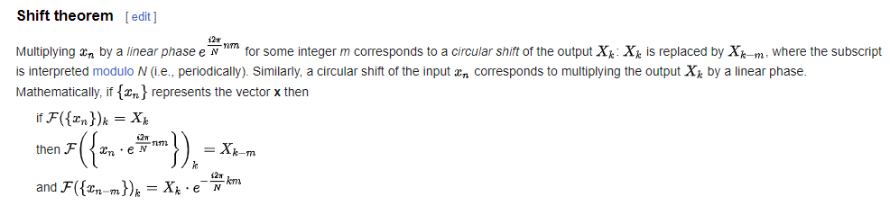

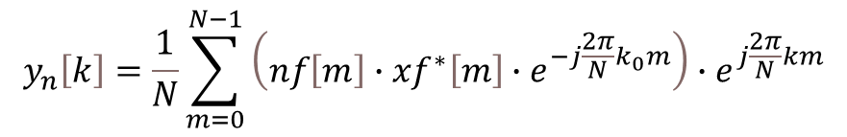
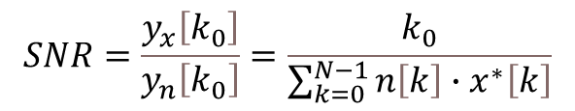

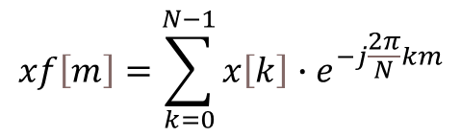


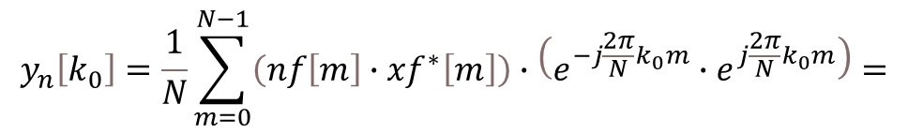

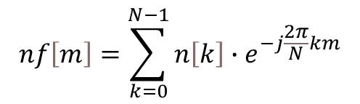


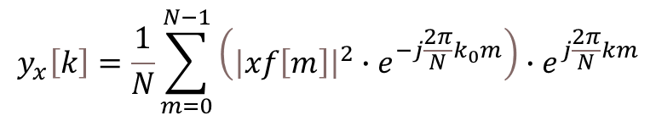
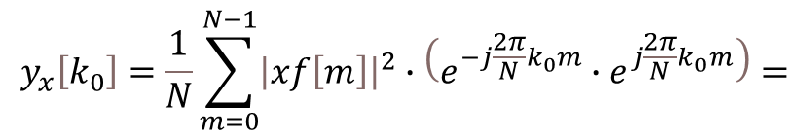

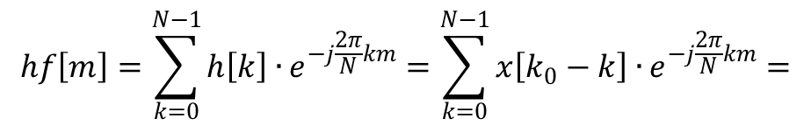

$$x\left[k\right]−input complex pulse signal, k=0…N−1$$
$$n\left[k\right]−input complex white noise$$
$$h\left[k\right]−complex impulse response$$
$$hf\left[m\right]=\sum_{k=0}^{N−1}{h\left[k\right]∙}e^{−j\frac{2π}{N}km}=\sum_{k=0}^{N−1}{x\left[k_{0}−k\right]∙}e^{−j\frac{2π}{N}km}=$$
$$h\left[k\right]=x\left[k_{0}−k\right]$$
$$={xf}^{∗}\left[m\right]{∙e}^{−j\frac{2π}{N}k_{0}m}$$
Matched Filtering in frequency domain
Noise
Signal
$$xf\left[m\right]=\sum_{k=0}^{N−1}{x\left[k\right]∙e^{−j\frac{2π}{N}km}}$$
$$nf\left[m\right]=\sum_{k=0}^{N−1}{n\left[k\right]∙e^{−j\frac{2π}{N}km}}$$
$$nf\left[m\right]∙hf\left[m\right]=nf\left[m\right]∙{xf}^{∗}\left[m\right]{∙e}^{−j\frac{2π}{N}k_{0}m}$$
$$xf\left[m\right]∙hf\left[m\right]={xf\left[m\right]∙xf}^{∗}\left[m\right]{∙e}^{−j\frac{2π}{N}k_{0}m}=$$
$$y_{n}\left[k\right]=\frac{1}{N}\sum_{m=0}^{N−1}{\left(nf\left[m\right]∙{xf}^{∗}\left[m\right]{∙e}^{−j\frac{2π}{N}k_{0}m}\right){∙e}^{j\frac{2π}{N}km}}$$
$${=\left|xf\left[m\right]\right|}^{2}{∙e}^{−j\frac{2π}{N}k_{0}m}$$
$$y_{x}\left[k\right]=\frac{1}{N}\sum_{m=0}^{N−1}{\left({\left|xf\left[m\right]\right|}^{2}{∙e}^{−j\frac{2π}{N}k_{0}m}\right){∙e}^{j\frac{2π}{N}km}}$$
$$y_{n}\left[k_{0}\right]=\frac{1}{N}\sum_{m=0}^{N−1}{\left(nf\left[m\right]∙{xf}^{∗}\left[m\right]\right)∙\left(e^{−j\frac{2π}{N}k_{0}m}{∙e}^{j\frac{2π}{N}k_{0}m}\right)}=$$
$$y_{x}\left[k_{0}\right]=\frac{1}{N}\sum_{m=0}^{N−1}{{\left|xf\left[m\right]\right|}^{2}∙\left(e^{−j\frac{2π}{N}k_{0}m}{∙e}^{j\frac{2π}{N}k_{0}m}\right)}=$$
$$=\sum_{k=0}^{N−1}{n\left[k\right]∙x^{∗}\left[k\right]}$$
$$=\sum_{k=0}^{N}{{\left|x\left[k\right]\right|}^{2}}=k_{0}$$
$$SNR=\frac{y_{x}\left[k_{0}\right]}{y_{n}\left[k_{0}\right]}=\frac{k_{0}}{\sum_{k=0}^{N−1}{n\left[k\right]∙x^{∗}\left[k\right]}}$$
aleksei.rostov@protonmail.com

